Slide 1
Respiratory Disease as a Cause of Death
Miaohan Lin, Ro Diaz

Slide 2
Introduction
Introduction (25%)
Data sets
Considerations of your data
Significance + Purpose
What we used (packages)
Methods of Analysis (25%)
Preprocessing
What visualizations were attempted but not included in final results
This is your discussion of progress
All work should be visible on Github
Results (25%)
Visualizations
Conclusions drawn
Discussion (25%)
A reflection of your progress
Moving forward, what would you consider doing if you were to continue this project

Slide 3
Introduction and background
Research Question: Which demographic-specific factors contribute to variations in mortality rates from respiratory diseases?
Understanding the prevalence and impact of respiratory diseases in specific demographics ,ay help public health officials and policy-makers develop targeted prevention and intervention strategies. By identifying high-risk populations, they can allocate resources more effectively to prevent and manage respiratory diseases.

Slide 4
Data Sets
AH_Monthly_Provisional_Counts_of_Deaths_for_Select_Causes_of_Death_by_Sex__Age__and_Race_and_Hispanic_Origin.csv
(Altered to list all “Female” in “Sex” as “F”, all “Male” in “Sex” as “M”)
New_York_City_Leading_Causes_of_Death.csv
(Altered to list all “Female” in “Sex” as “F”, all “Male” in “Sex” as “M”)
(Altered to remove all rows where “Deaths” has value “.”)
For consideration (take this with a grain of salt):
Only AH data has values for “Other respiratory diseases”, is taken nationally
NY data was taken solely from the state of NY.
Data is taken in AH data over months, data is taken in NY data over years.

Slide 5
What We Used
PyCharm IDE
Numpy as np
(package, installed but unused)
Matplotlib.pyplot as plt
(package, installed and used)
Read files
Make dataframes
Select values from dataframes and files
Pandas as pd
(package, installed and used)
Plots (all)

Slide 6
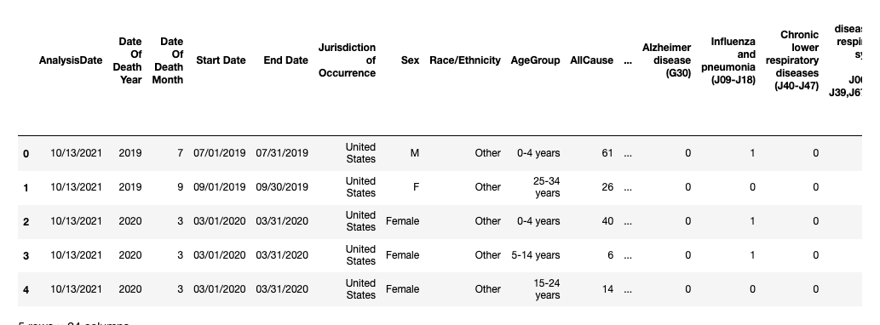
Methodology (Process and Difficulties)
Selected purpose (see: “Introduction and Background”)
Cutting down on scope (initial attempt was too broad)
Beginning project
NY data difficulty
ORD considerations

Slide 7
What did we not use?
The datasets we decided to use included a multitude of different diseases as a cause of death.
We found that it was difficult to keep track of and run tests on all the diseases, so we decided to focus solely on respiratory diseases.
Looking at multiple factors meant there was a higher chance of confounding variables which muddled our results.
We weren’t able to run t-tests or a generalized linear model on the data to get a p-value within the program.
*ORD (see: conclusions)

Slide 8
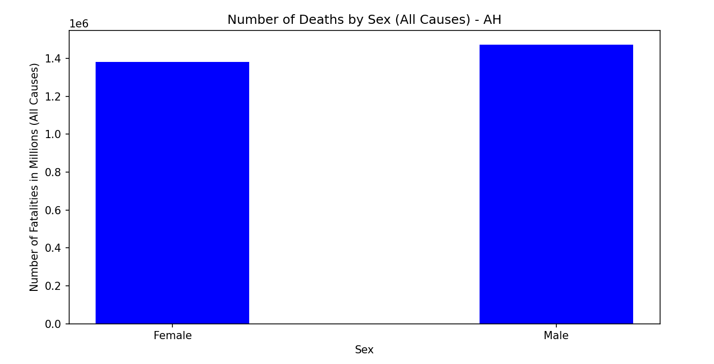
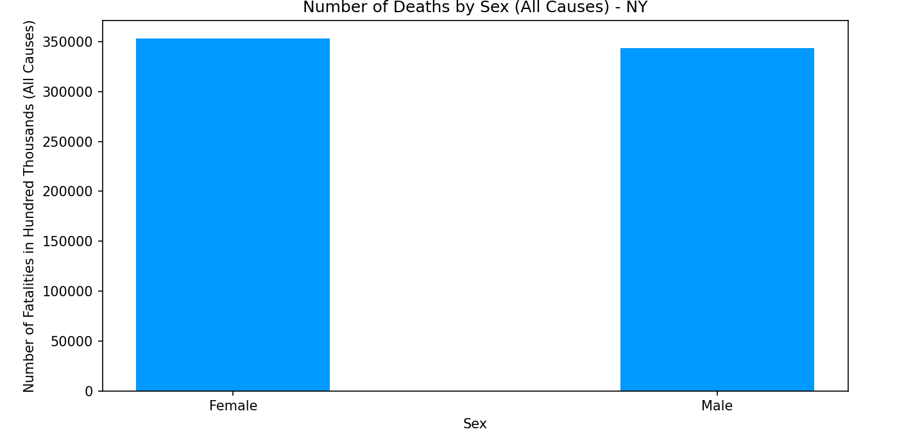
Visualisations (All Causes)

Slide 9
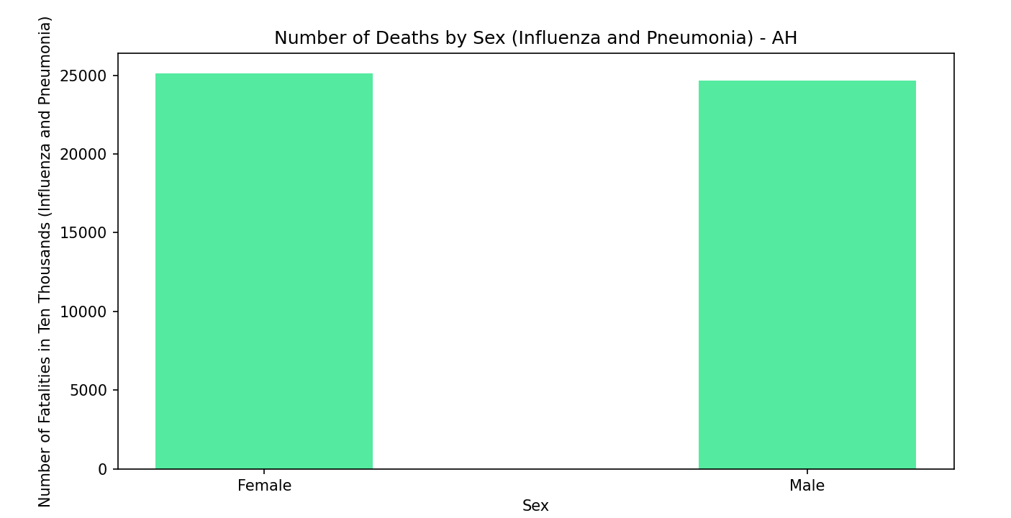
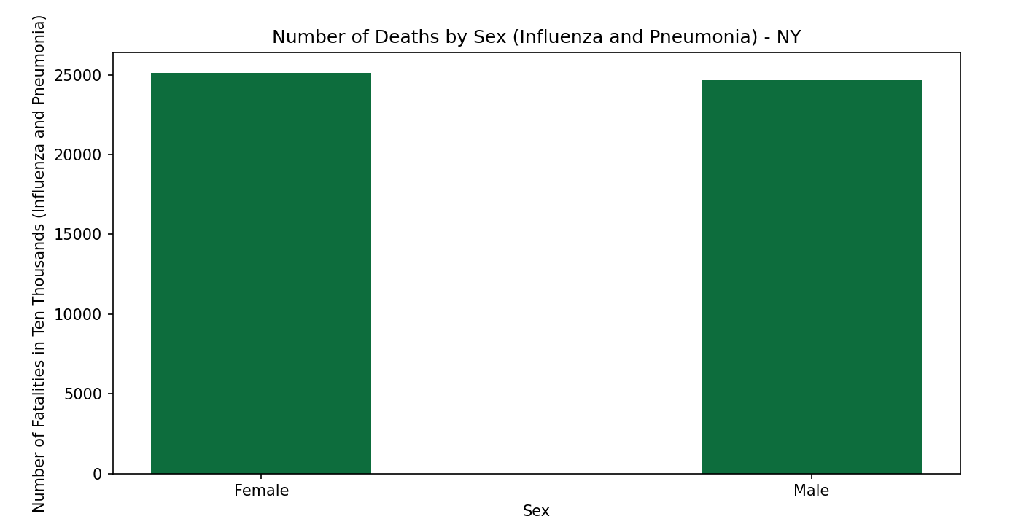
Visualisations (Influenza and Pneumonia)

Slide 10
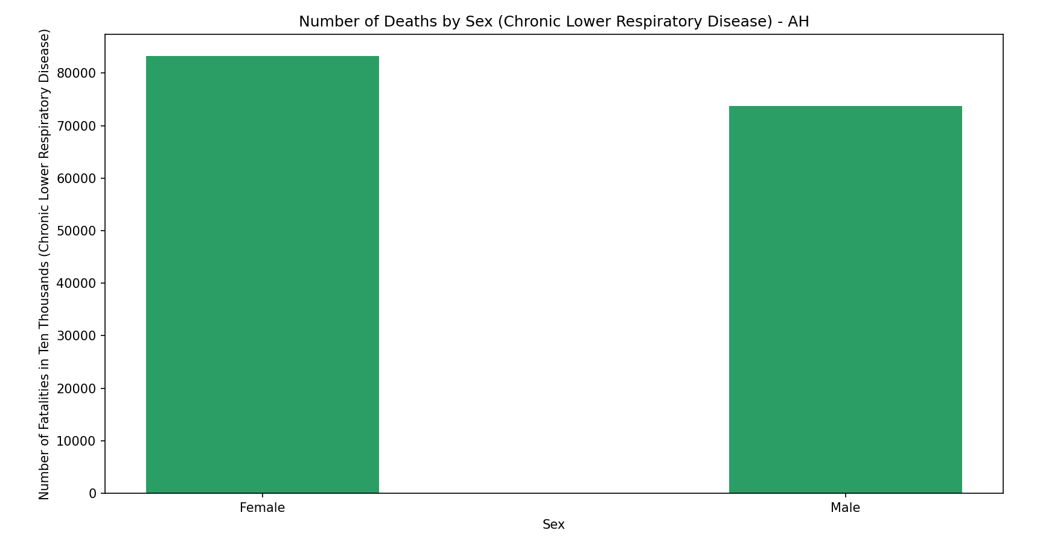
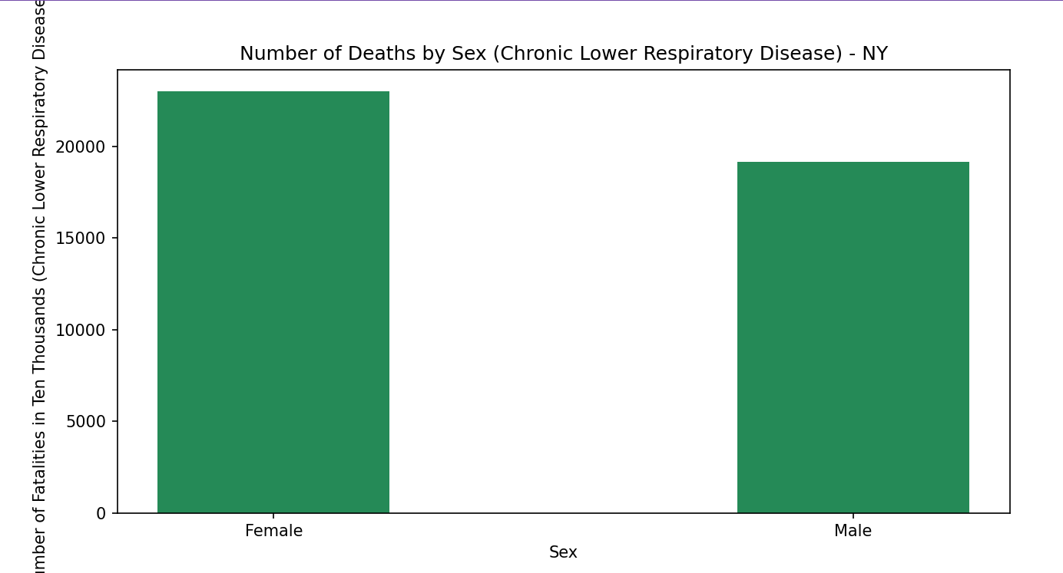
Visualisations (Chronic Lower Respiratory Disease)

Slide 11
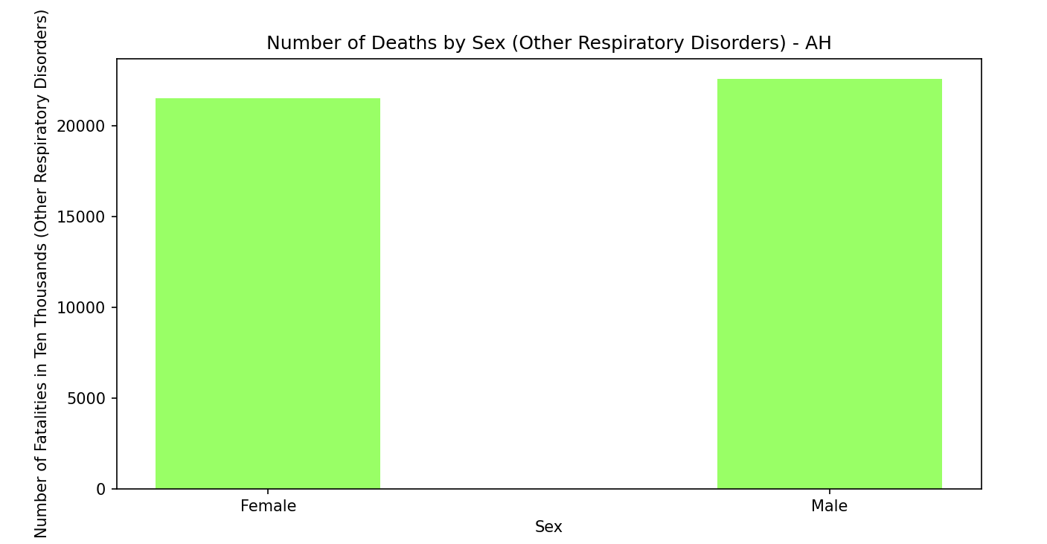
Visualisations (Other Respiratory Diseases)

Slide 12
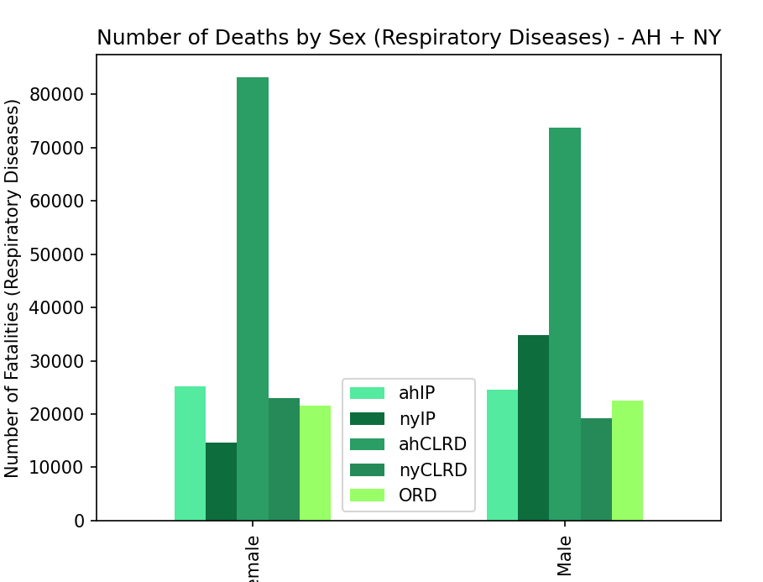
Visualisations (All Respiratory Diseases)

Slide 13
Results
For AH:
~ 1.82% of all female deaths, ~ 1.67% of all male deaths were influenza or pneumonia
~ 50.50% of influenza + pneumonia deaths were female, ~ 49.50% were male
~ 6.03% of all female deaths, ~ 5.00% of all male deaths were CLRD
~ 53.04% of CLRDT deaths were female, ~ 46.96% were male
~ 1.56% of total female deaths, ~ 1.53% of total male deaths were of ORD
~ 48.82% ORD deaths were female, ~ 51.18% ORD deaths were male

Slide 14
Results
For NY:
~4.14% of all female deaths, ~ 12.10% of all male deaths in NY data were influenza or pneumonia
~ 29.61% of influenza + pneumonia deaths were female, ~ 70.39% were male
~ 6.51% of total female deaths, ~ 5.57% of total male deaths in NY data were CLRD
~ 54.60% of CLRDT deaths were female, ~ 45.40% were male

Slide 15
Conclusions
-AH v NY (Influenza and Pneumonia) (potential 1:3 f:m ratio)
-Chronic Lower Respiratory Disease (f trends higher)
BONUS: Other Respiratory Diseases (Covered on “Results (Other Respiratory Diseases)”)

